Slide 1
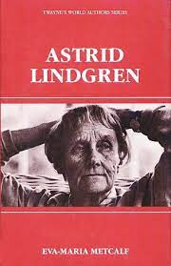

Slide 2
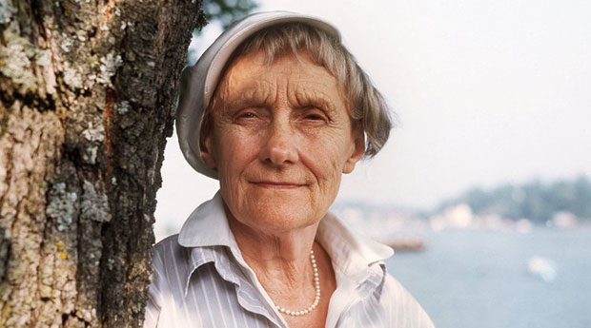
Astrid Lindgren
Astrid Lindgren is a Swedish born author. She was born as Astrid Anna Emilia Ericsson on 1907 in Vimmerby in the province of Smaland, in Southern Sweden where she grew up on a farm. Her early childhood was spent with cows and discovering hidden forest paths. Astrid was born to liberal parents, the second of four children of Samuel August, a tenant farmer, and Hanna Jonsson Ericsson. During their childhood years, they were nurtured into storytelling; and were taught how to use their imagination and creativity in the world of Literature. Her childhood years were full of love and laughter, which came from her parents. The laughter extended more in the games that Astrid played with her three siblings, Gunnar, Stina and Ingegerd. Many of the settings and characters in Astrid’s books can be traced back to her own childhood.

Slide 3
As an author, she had a certain impact on the world of children’s literature. Her books on children are loved all around the globe. Pippi Longstocking, one of the most loved books, has been translated into 60 languages. It has sold over five million copies in the United States alone. This character was created after the birth of her daughter, Karin. A number of people objected to this character as she was portrayed to be dangerous. Her debut in writing was made at a time when women were mostly involved with domestic work or engaged in stuff like embroidery. Astrid disregarded the barriers that came her way and went straight to strike for what she believed in. Pippi jumped right into the world of boys and grown-ups without any permission. She was bold and gave her opinion on anything to anyone. Pippi would never just sit and wait for her prince charming to come riding on his white stallion. She had her own horse.

Slide 4
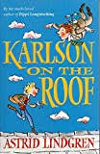
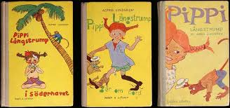
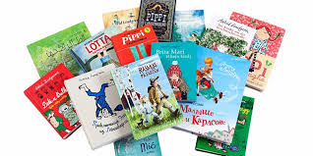
Lindgren has also challenged conservative codes of children’s literature in later works. Her novel The Brothers Lionheart brought up the taboo of the death and the doctrine of reincarnation. Mio, min Mio, a classical story dealt with good and evil, which has sources from the Bible, folk tales, and lyric poetry.

Slide 5
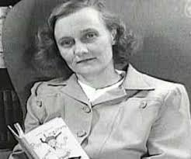
Lindgren had considerable public influence, however, she used it scarcely. Her constant concern with animal welfare was active in passing a new law in 1988 controlling factory farming, which put Sweden among the most developed countries on this issue. Lindgren’s humor and love for humanity was legendary. She represented the Swedish spirit for the rest of the world. She speaks out on behalf of living life against violence. Her books have put across loving relationships, liberation and fondness for nature. She passed away at the age of 94, after a very productive and artistic life.

Slide 6
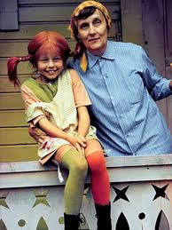
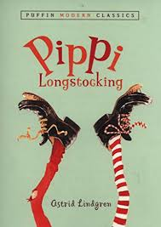

Slide 7
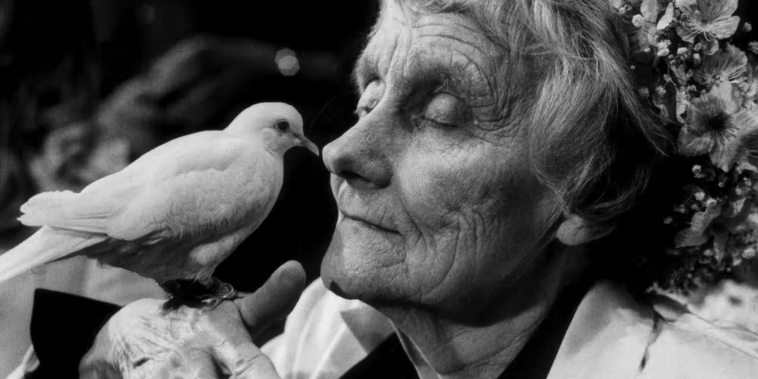
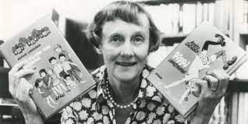
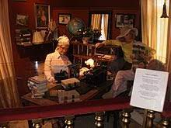

Slide 8
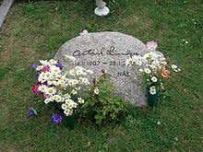
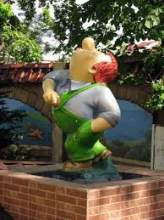
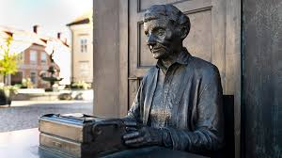
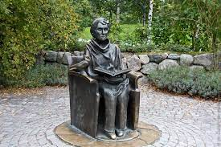

Slide 9
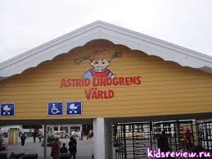

Slide 10
